Slide 1
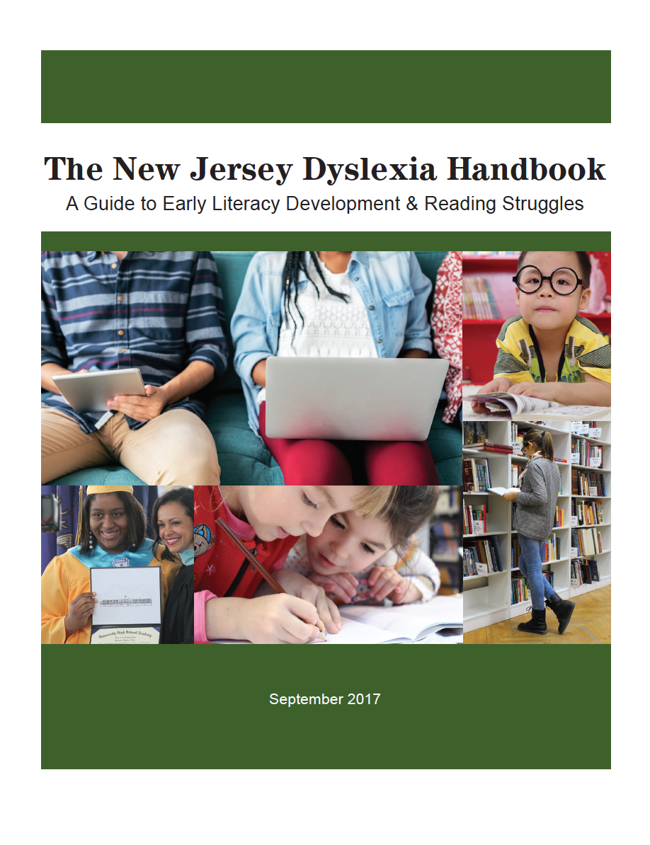
Exploring The New Jersey Dyslexia Handbook:
A Guide to Early Literacy Development &
Reading Struggles
Session 3
Notes:
Welcome to session 3 of the webinar series “Exploring the New Jersey Dyslexia Handbook: A Guide to Early Literacy Development and Reading Struggles.” This four part webinar series is designed to help school districts become familiar with the guidance contained in the state handbook and to support district-based stakeholder teams in making the best educational programming decisions for the students in their schools. This series can be used as an implementation tool for districts interested in building a strong preventive model of screening and tiered intervention for students struggling in the area of reading. Each installment will provide team members with an overview of content and activities to support the team members in translating the information discussed into best practices in their schools and classrooms.
In this third installment, we will review the intervention and assistive technology sections of the handbook.

Slide 2
Intervention: A Structured Literacy Framework
for Struggling Readers
DECODING
LANGUAGE
COMPREHENSION
READING COMPREHENSION
x
=
The Simple View of Reading
Notes:
As educators design intervention practices to meet the needs of struggling readers, especially those with dyslexia, it will be important for key implications documented by researchers to be recognized and woven into the district or school level plans.
Researchers describe reading comprehension as the product of word recognition or decoding skills and language comprehension. These components work together in a delicate, interdependent balance. When there is a disconnection between these components, reading failure can occur. This model is referred to as the simple view of reading.

Slide 3
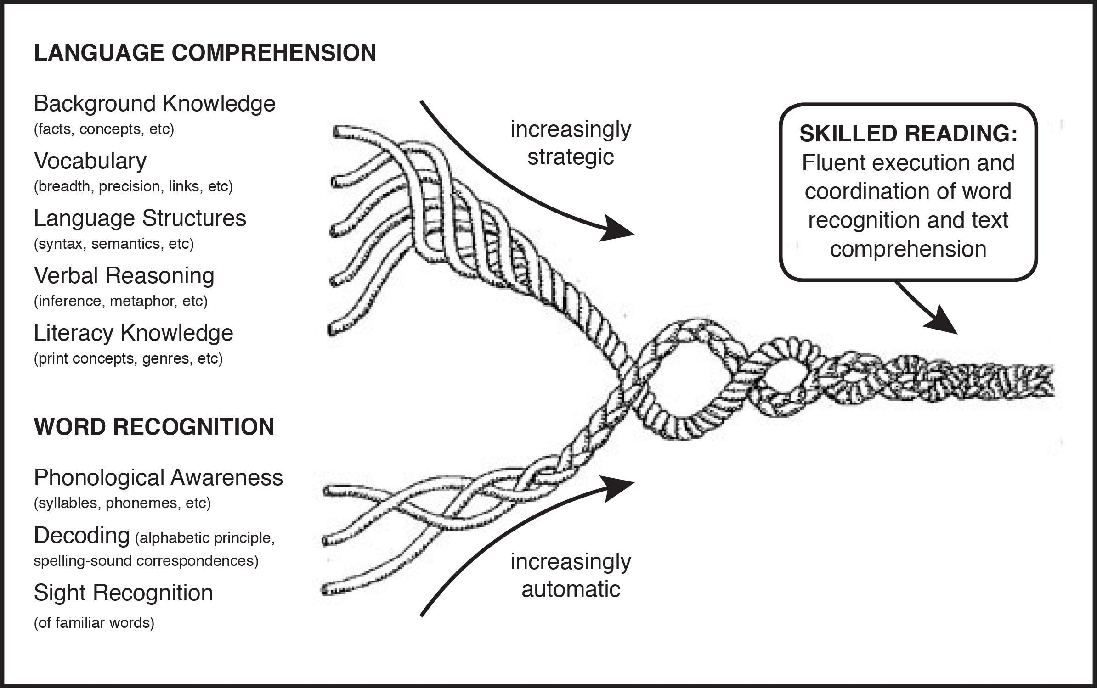
Scarborough, 2001
Notes:
Dr. Hollis Scarborough, a leading researcher in literacy, expands this simple view of reading and shares that reading is a multifaceted skill that is gradually acquired through years of instruction and practice. Scarborough’s Reading Rope (seen here) illustrates how the many skills that are required for comprehending texts are intertwined. A student’s word recognition skills must become increasingly automatic over time while their ability to apply their language comprehension skills must become increasingly more strategic. These skills and abilities enable a student to coordinate word recognition and text comprehension in order to fluently read connected text. The strands weave together over many years as the student becomes a skilled, proficient reader.

Slide 4
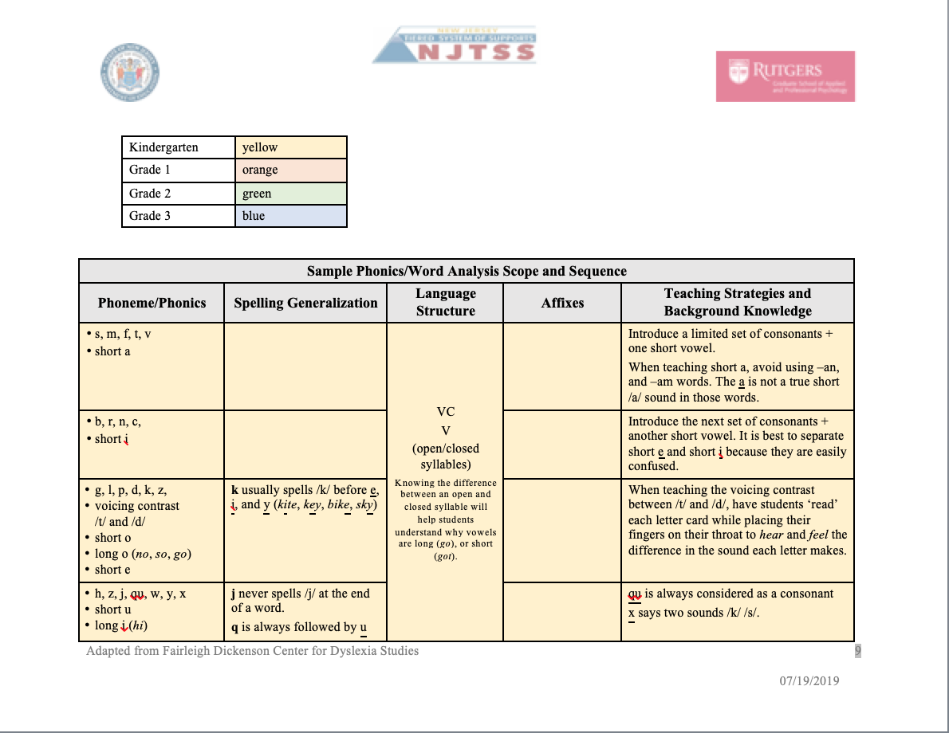
Intervention: A Structured Literacy Framework
for Struggling Readers
Structured Literacy Instruction:
is explicit, systematic, cumulative, and multimodal
emphasizes the structure of language
⇨ TOOL: Sample Scope and Sequence Chart
⇨ TOOL: NJTSS Sample Phonics Scope and Sequence
Notes:
There has been widespread consensus in the dyslexia community since the 1990s, that providing intervention by a skilled teacher using direct, systematic and sequential instruction, focused on the structure of language will enable students with dyslexia to make the greatest progress in reading achievement.
Popularly employed reading approaches, such as guided reading or balanced literacy, are not in and of themselves, sufficient for struggling readers and not effective for dyslexic students. These approaches do not provide sufficient instruction in decoding and the essentials of the structure of language.
Structured literacy is instruction that is explicit, systematic, cumulative, and multisensory. This type of intervention emphasizes the structure of language including the speech sound system known as phonology, the writing or spelling system known as orthography, sound/symbol association, the structure of sentences known as grammar or syntax, the meaningful parts of word - morphology, the meaning of and relationships among words - semantics, and the organization of spoken and written discourse. Multisensory, or a more accurate term “multimodal”, instructional strategies are typically employed in Structured Literacy instruction. These involve the simultaneous use of visual, auditory, tactile-kinesthetic sensory systems such as articulatory motor components linking the students listening, speaking, reading and writing.
Effective reading instruction uses a comprehensive scope and sequence to guide instruction across a school year and up through the grade levels. The NJ Department of Education provides two tools that highlight this logical skill sequence that builds on previously learned skills and allows for the evaluation of gaps and redundancies across grade levels. The dyslexia handbook includes a brief Sample Scope and Sequence Chart and a more robust example can be found in the NJTSS Sample Phonics Scope and Sequence document. Take a look at these tools and consider using them as roadmap for establishing clear, research-based, grade-level skill instruction in the essential components of reading in your school.

Slide 5
Intervention: A Structured Literacy Framework
for Struggling Readers
Instructional tasks are modeled, when appropriate.
Direct, explicit instruction is provided.
Meaningful interactions with language occur during the lesson.
Multiple opportunities are provided to practice instructional tasks.
Corrective feedback is provided after initial student responses.
Student effort is encouraged.
Lesson engagement during teacher-led instruction is monitored.
Lesson engagement during independent work is monitored.
Students successfully complete activities at a high criterion level of performance.
Notes:
There are also some important instructional principles associated with the provision of Structured Literacy instruction:
Instructional tasks are modeled, when appropriate.
Direct, explicit instruction is provided – meaning concepts are explained to students clearly and directly. Explicit instruction often includes modeling through an “I do, we do, you do” progression.
Meaningful interactions with language occur during the lesson, often instruction makes use of all sensory pathways, at the same time whenever possible. This includes multiple modalities including visual, auditory, tactile, and kinesthetic pathways that integrate listening, speaking, reading and writing
Multiple opportunities are provided to practice instructional tasks.
Corrective feedback is provided after initial student responses.
Student effort is encouraged.
Lesson engagement during teacher-led instruction and independent work is monitored.
And finally students successfully complete activities at a high criterion level of performance.

Slide 6
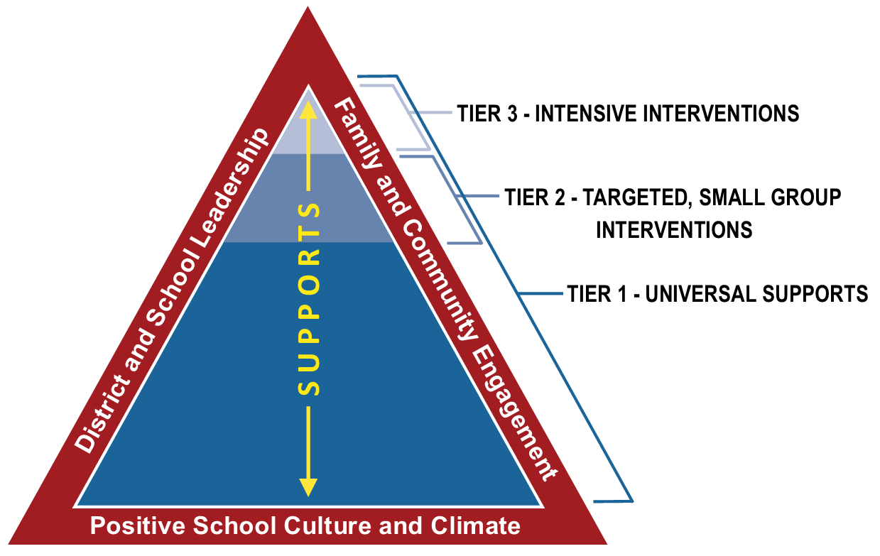
Notes:
A data-driven, prevention-based approach to literacy instruction, such as NJTSS is key. Students will need access to Tier 1 core instruction that includes a clear scope and sequence for evidence-based, grade-level skill instruction in the essential components of reading and universal supports. Tier 2 and tier 3 services should build upon this foundational core instruction providing students targeted, small group and intensive interventions as needed.

Slide 7
When Should Remedial Services Be Discontinued?
It is important that students are not prematurely discontinued from Tier 2 or Tier 3 intervention services.
Notes:
As students become proficient with reading and spelling tasks and begin to demonstrate the ability to perform satisfactorily in the classroom, it is important that they are not prematurely discontinued from Tier 2 or Tier 3 intervention services. While Tier 1 core reading instruction should continue to build all students’ advanced knowledge of the structure of the English language, small group or intensive, individualized interventions should continue as long as they are needed.

Slide 8
When Should Remedial Services Be Discontinued?
“In general, when a child is just gaining momentum in reading is the time for an all-out push and never the time for an abrupt halt to instruction.
Simply teaching a child how to sound out words without providing him with practice in applying this skill to reading will likely result in a child who can sound out some words but has difficulty reading the many new words he comes across as he progresses in his studies. He will not be a fluent reader, and reading will remain effortful. Left alone, he will avoid reading. So this is the time to maintain the same level of intensity and quality of instruction while targeting fluency as well.”
–Dr. Sally Shaywitz
Notes:
In her book Overcoming Dyslexia, Dr. Sally Shaywitz discusses when reading programs should be discontinued stating that “In general, when a child is just gaining momentum in reading is the time for an all-out push and never the time for an abrupt halt to instruction.
Simply teaching a child how to sound out words without providing practice in applying this skill to reading will likely result in a child who can sound out some words but has difficulty reading the many new words they comes across as they progresses in their studies. He or she will not be a fluent reader, and reading will remain effortful. Left alone, the child will avoid reading. So this is the time to maintain the same level of intensity and quality of instruction while targeting fluency as well.”

Slide 9
When Should Remedial Services Be Discontinued?
It is important that students are not prematurely discontinued from Tier 2 or Tier 3 intervention services.
Students should not be removed from an effective reading program until they are able to read words and passages fluently, at their grade level.
Reading assessment data should document students’ abilities:
  to exhibit mastery of the phonological code, accuracy and automaticity of word recognition, and fluent reading of connected text with good comprehension.
  to generalize and transfer these abilities into classroom settings before intervention services are pulled back. Scaffolds should be provided to students in the general education setting to increase their independence in applying these skills to grade level reading and writing tasks.
Notes:
She goes on to repeat that “a child should not be removed from an effective reading program until they are able to read words and passages fluently, at grade level.”
Reading assessment data should document students’ abilities to exhibit mastery of the phonological code, accuracy and automaticity of word recognition, and fluent reading of connected text with good comprehension. Students should be able to generalize and transfer these abilities into classroom settings before intervention services are pulled back. Scaffolds should be provided to students in the general education setting to increase their independence in applying these skills to grade level reading and writing tasks.

Slide 10
Role of the Administrator
Organizing continued professional development programs so that both new and seasoned educators receive information about best practices and research in the field of dyslexia;
Providing for ongoing coaching and mentoring in evidence-based practices;
Determining curriculum that allows for differentiated instruction and permits teachers to remediate the phonological/orthographic deficits associated with dyslexia;
Notes:
Organizing and implementing these models of effective assessment, instruction and intervention in schools can be a very challenging task.
School administrators play a crucial role in meeting the needs of all students, including those with dyslexia and other reading struggles by:
Organizing continued professional development programs so that both new and seasoned educators receive information about best practices and research in the fields of literacy and dyslexia;
Providing for ongoing coaching and mentoring in evidence-based practices;
and Determining curriculum that allows for differentiated instruction and permits teachers to remediate the phonological and orthographic deficits associated with dyslexia;

Slide 11
Role of the Administrator
Prioritizing the scheduling for intervention instruction so that well-trained teachers have uninterrupted instructional time with appropriate grouping of students, resources and opportunities to collaborate with colleagues who also teach their students;
Developing systems for analyzing assessment and progress monitoring data to ensure that instruction is effective and is appropriately sustained until deficits are overcome and students are fluent, automatic readers; and
Overseeing implementation of a multi-tiered system of support, such as NJTSS, as a framework for a systematic approach to prevention, intervention, and enrichment.
Notes:
Prioritizing the scheduling for intervention instruction so that well-trained teachers have uninterrupted instructional time with appropriate grouping of students, resources and opportunities to collaborate with colleagues who also teach their students;
Developing systems for analyzing assessment and progress monitoring data to ensure that instruction is effective and is appropriately sustained until deficits are overcome and students are fluent, automatic readers.
and Overseeing implementation of a multi-tiered system of support, such as NJTSS, as a framework for a systematic approach to prevention, intervention, and enrichment

Slide 12
Accommodations & Modifications
Meet unique, individual needs and increase participation
Not a replacement for evidence-based instruction
Common accommodations for dyslexia: extra time, copies of notes, outlines for textbook reading, study guides, “to do” checklists…
Use of assistive technology can be key!
Notes:
Students with dyslexia frequently experience barriers to fully participate in classroom activities. Whether the difficulties arise from struggles with reading, written expression, or other obstacles, providing students with accommodations and modifications will increase their opportunities to participate and thrive in academic and extracurricular settings.
An accommodation is a change in timing, formatting, setting, scheduling, response or presentation that allows a student to complete the same assignment, test or task as other students by compensating for their weaknesses. They do not alter the content of assignments, or change what an assignment or test is designed to measure; rather accommodations are meant to provide equal access to the curriculum and an equal opportunity for students to show what they know. For example, students who struggle with reading fluency may be provided extra time for reading assignments so they can focus on reading the text at a pace that supports their reading comprehension.
Modifications are changes to tasks, assignments, and assessments that alter content and expectations. Modifications can change the standards or the level of difficulty of assignments. Students who struggle to read, for example, may be assigned an abridged version of a book that their classmates are reading in the original format.
Accommodations and modifications are not meant to take the place of intensive, evidence-based instruction to develop skills, but rather are effectively used when the goal of the task or assignment is for students is to acquire content-based knowledge or produce content-based outputs. Accommodations used during classroom instruction should also be considered for district and statewide assessment, as appropriate.
The handbook contains a nice list of common accommodations for students with dyslexia, as well as
information on assistive technology. AT is defined as any item, piece of equipment, or product system, whether acquired commercially off the shelf, modified, or customized, that is used to increase, maintain, or improve functional capabilities of a child with a disability. For many students with dyslexia, AT is a crucial accommodation that acts as a bridge between their area of weakness and their actual abilities and skills.

Slide 13


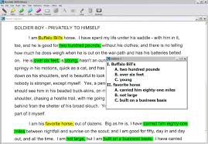
Assistive Technology
Notes:
AT can enable access to material at their grade level through the use of text-to speech software and audiobooks; enable students to express their thoughts in writing through the use of speech-to-text software, keyboards and word processing or word prediction software; as well as enable students to create notes through the use of recording devices such as recording pens or software.

Slide 14
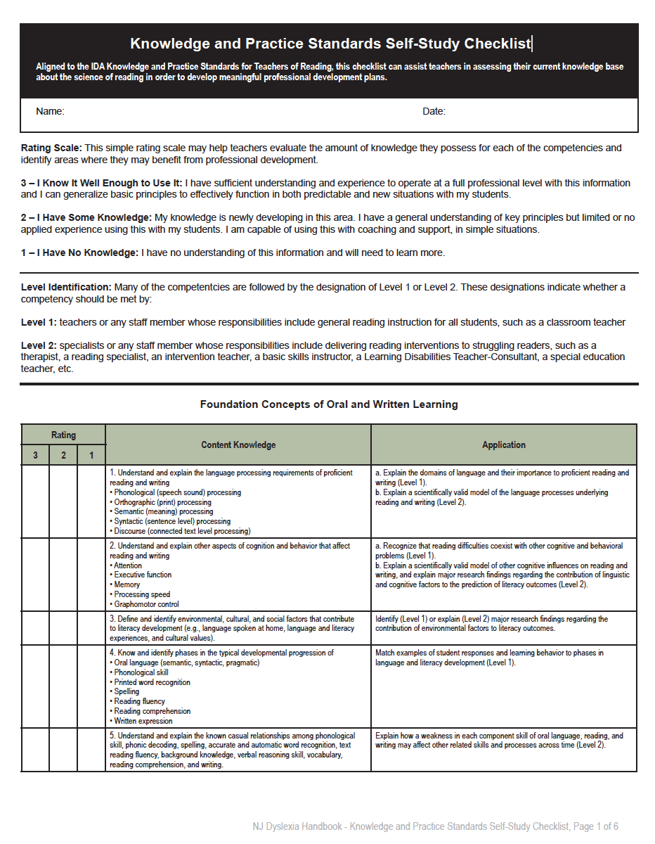
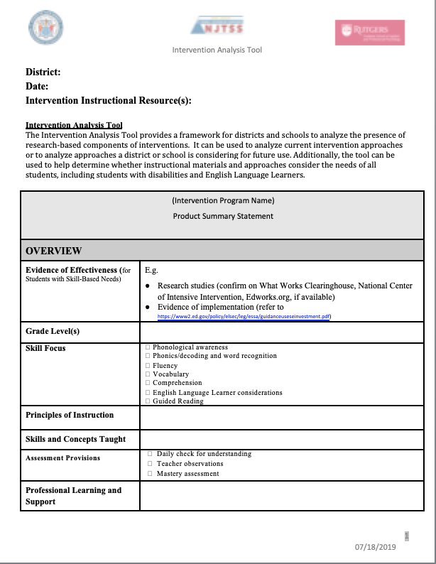
Activity: Intervention Checklist
⇨ TOOL: Components of Structured Literacy Intervention Checklist
⇨ TOOL: NJTSS Intervention Analysis Tool
Notes:
As we bring this third session of the webinar series to a close, we will again leave you with a follow up activity. Hopefully these activities have been helpful as your team members translate the information discussed in the webinars into best practices in your schools and classrooms.
It is important to analyze not only your core instruction program, but also your current intervention approaches being utilized in Tiers 2 and 3 to be sure they take into account the needs of all students particularly those with dyslexia. Included in the handbook is the Components of Structured Literacy Intervention Checklist, a brief rubric designed to help your team evaluate intervention programs. You can also access the NJTSS Intervention Analysis Tool, a framework for districts and schools to analyze the presence of research-based components of interventions. This tool can be used by a stakeholder team to analyze your current intervention approaches or to analyze approaches you may be considering for future use. Additionally, this tool can be used to help determine whether instructional materials and approaches consider the needs of all students, including students with disabilities and English Language Learners.
Take some time to think about how these tools can be used in your school to design a strong system of tiered intervention support for struggling readers.

Slide 15
Thank You!
Reminder: Complete the activities included here and then tune in for Session 4
Notes:
We’ll look forward to having you join us for session 4 of “Exploring the New Jersey Dyslexia Handbook: A Guide to Early Literacy Development and Reading Struggles” in the near future.

